Slide 1





GenAI-Logic
Prompt
API
Logic
Notes:
docs/images/web_genai/overview.png
https://lucid.app/lucidchart/93074dbf-b4a2-4e17-87ab-9cfbebde0961/edit?viewport_loc=-11%2C-11%2C1587%2C1001%2Csm-r5cTcziTX&invitationId=inv_7938bdf5-5e69-4967-973e-bd39ab44cebd

Slide 2
GenAI-Logic
API
Logic
Notes:
docs/images/web_genai/overview.png
https://lucid.app/lucidchart/93074dbf-b4a2-4e17-87ab-9cfbebde0961/edit?viewport_loc=-11%2C-11%2C1587%2C1001%2Csm-r5cTcziTX&invitationId=inv_7938bdf5-5e69-4967-973e-bd39ab44cebd

Slide 3
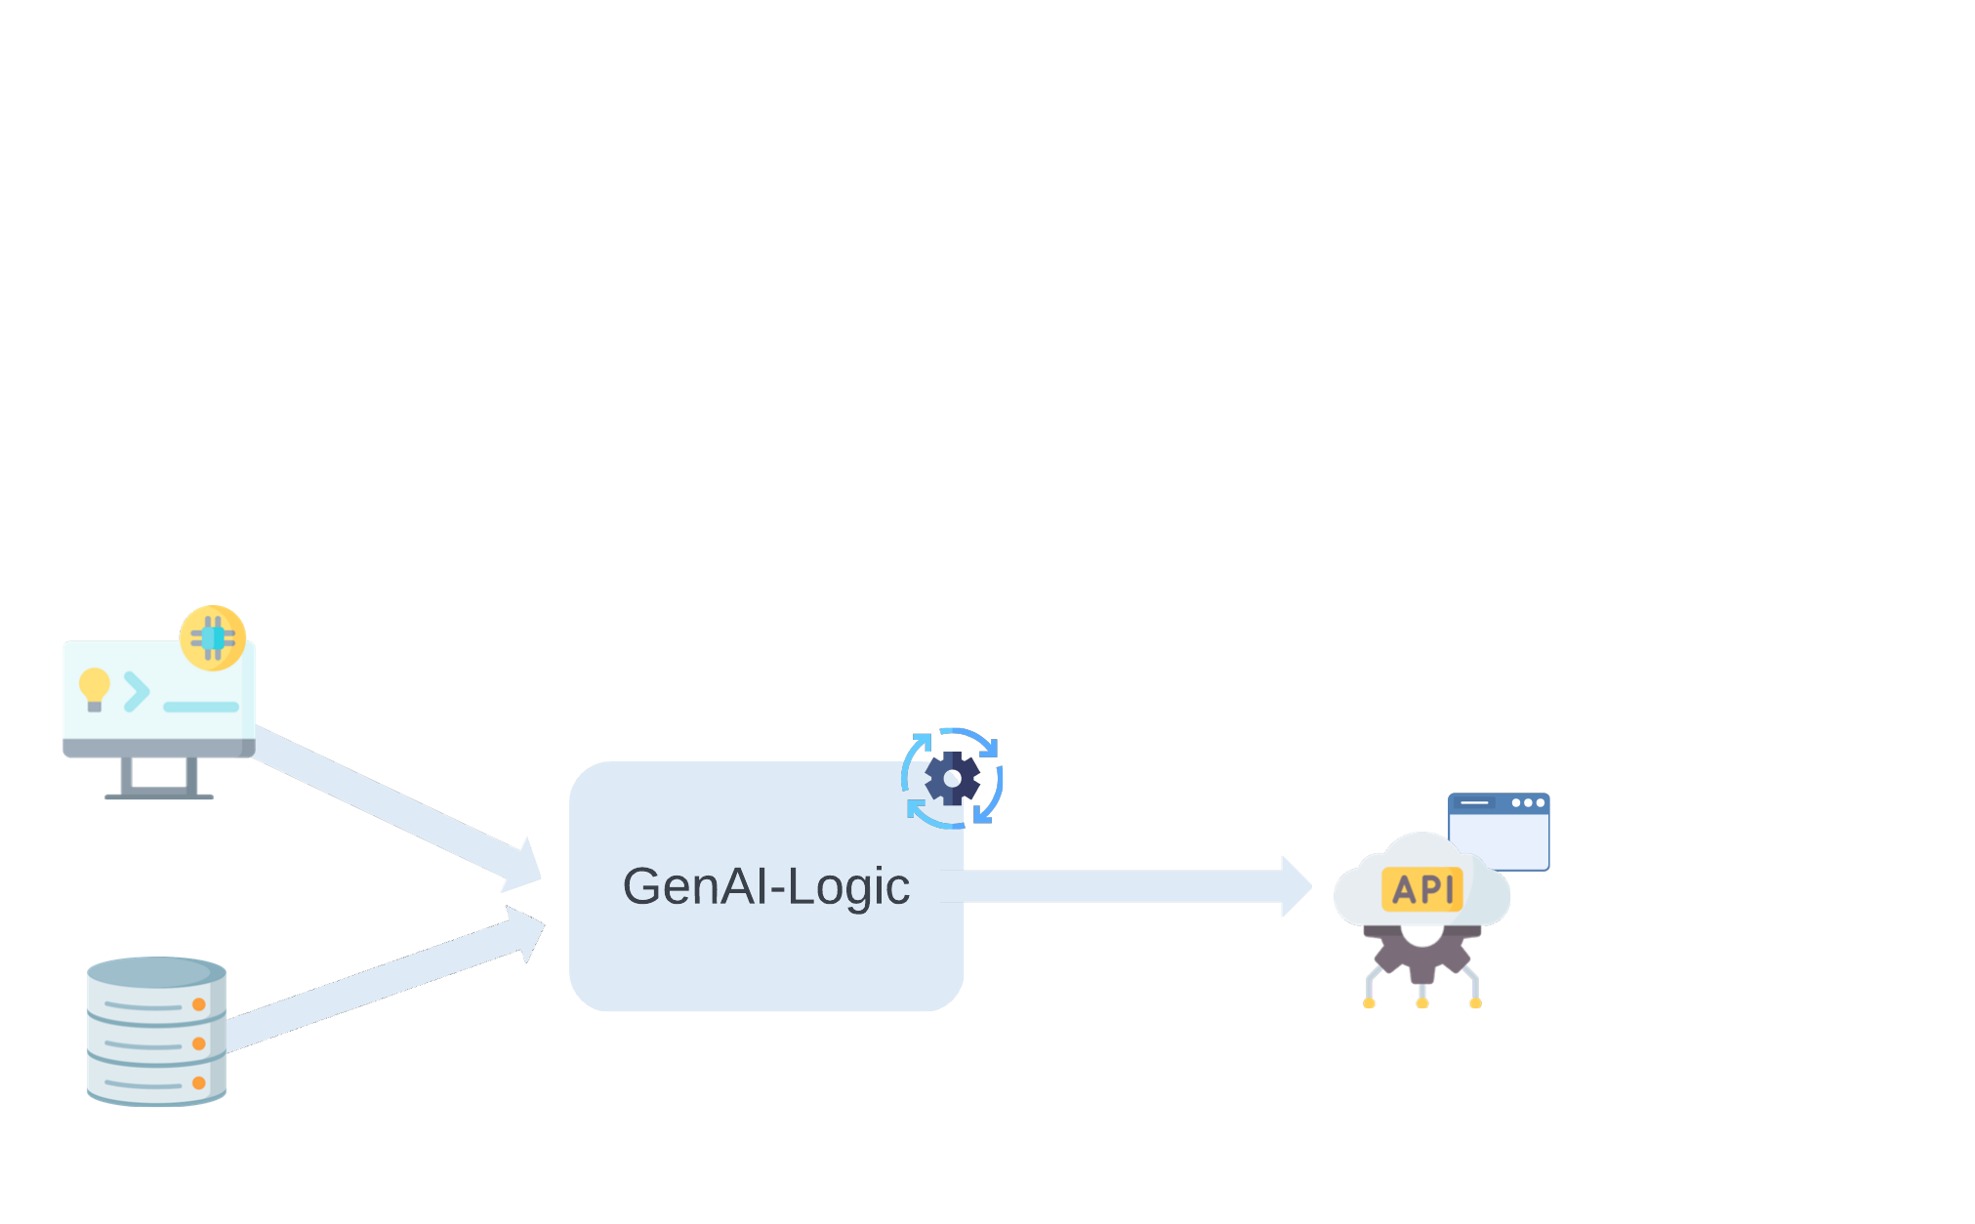
Notes:
docs/images/web_genai/overview.png
https://lucid.app/lucidchart/93074dbf-b4a2-4e17-87ab-9cfbebde0961/edit?viewport_loc=-11%2C-11%2C1587%2C1001%2Csm-r5cTcziTX&invitationId=inv_7938bdf5-5e69-4967-973e-bd39ab44cebd

Slide 4
Prompt
GenAI-Logic
DB
Microservice
2. Existing Database
JSON:API + logic
Admin App
Database (if prompt)
Notes:
docs/images/web_genai/overview.png

Slide 5

Microservice
GenAI-Logic
DB
JSON:API + logic
Admin App
Database
Notes:
docs/images/web_genai/overview.png

Slide 6
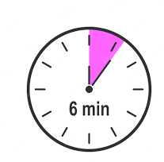

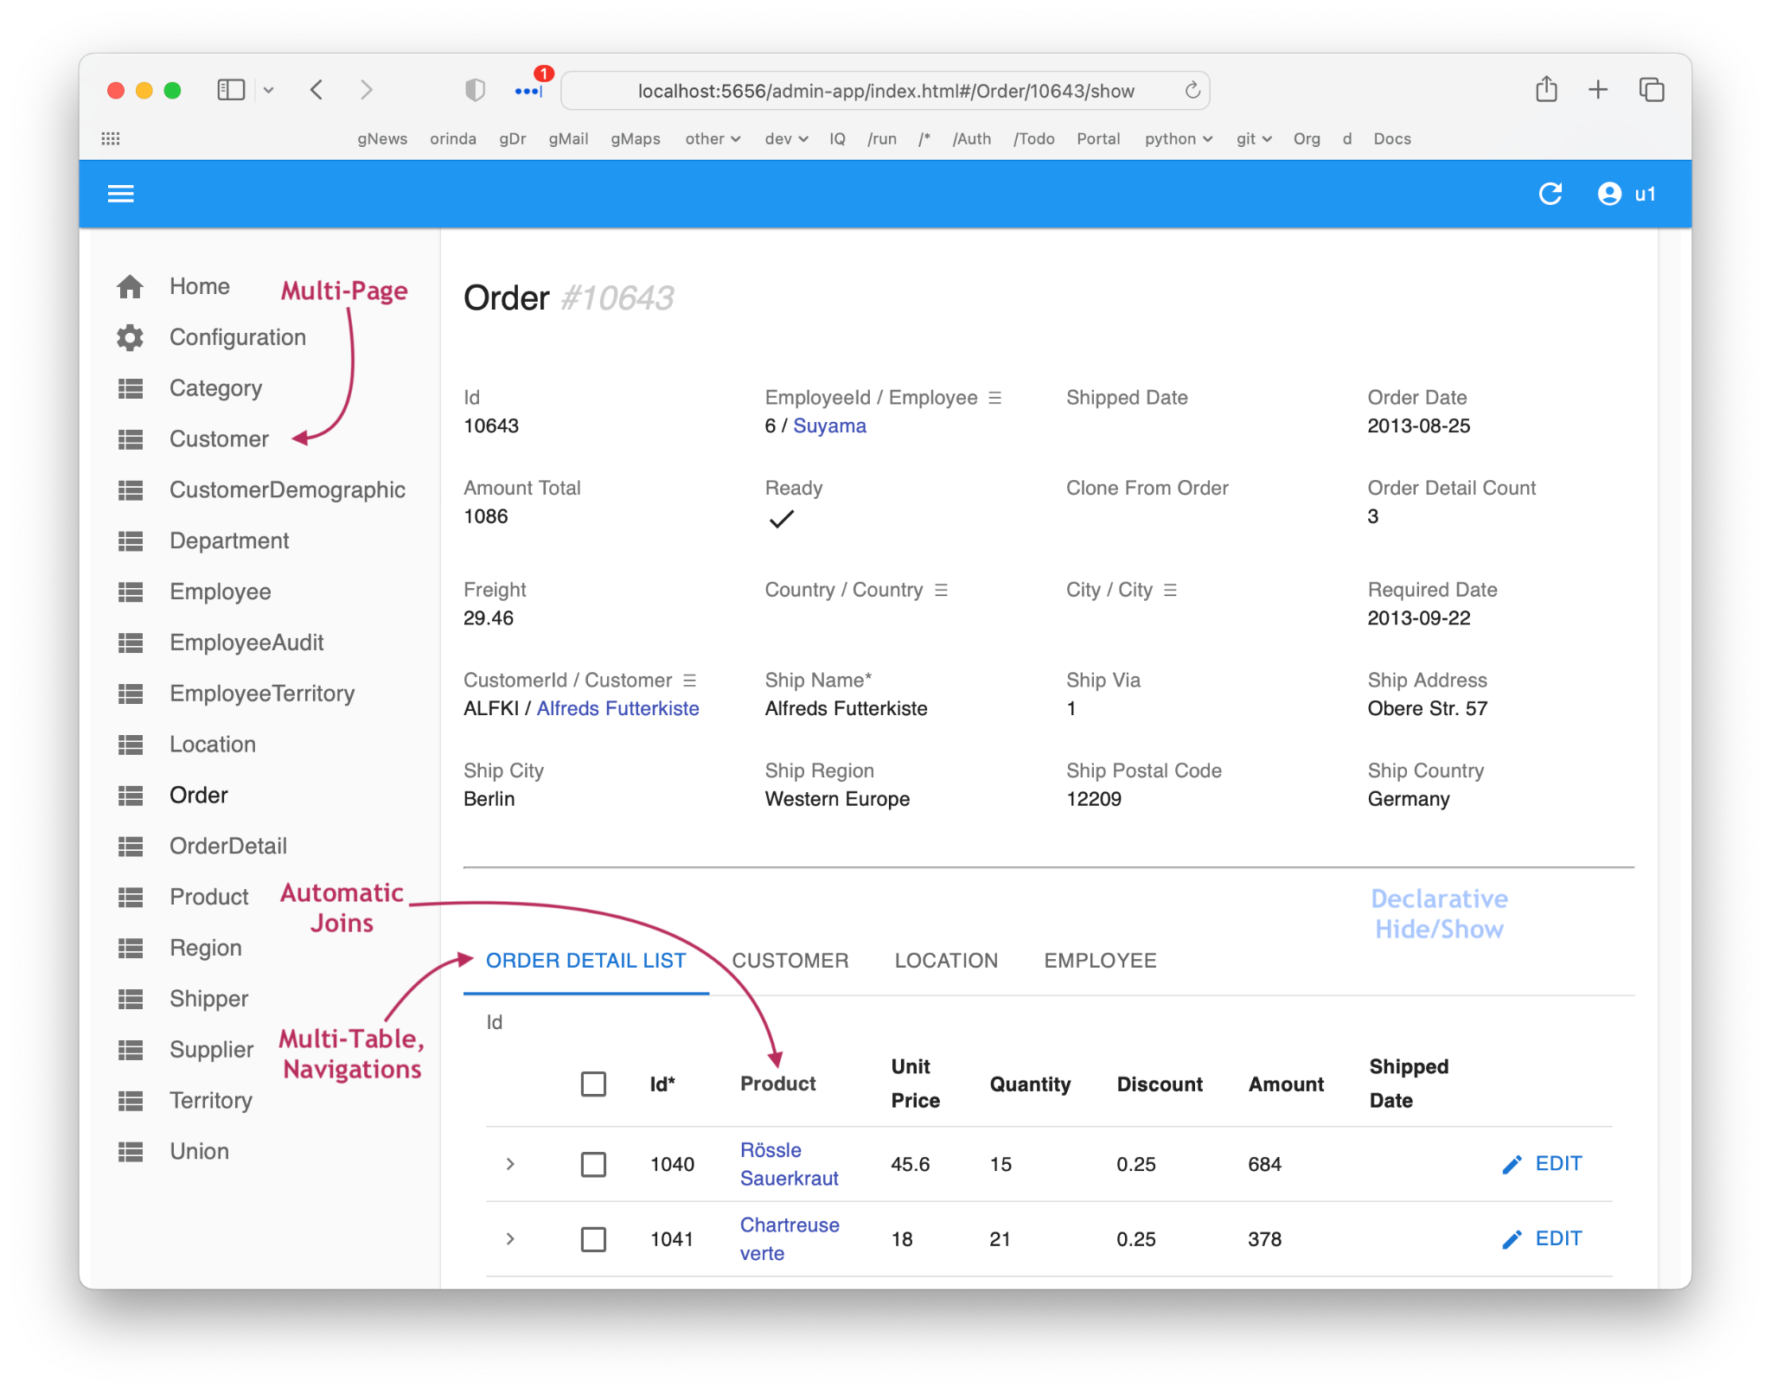
Microservice
NL Prompt
JSON:API
Logic Server
GenAI-Logic
or
DB
Existing DB
Notes:
docs/images/web_genai/overview.png

Slide 7



Slide 8


Slide 9
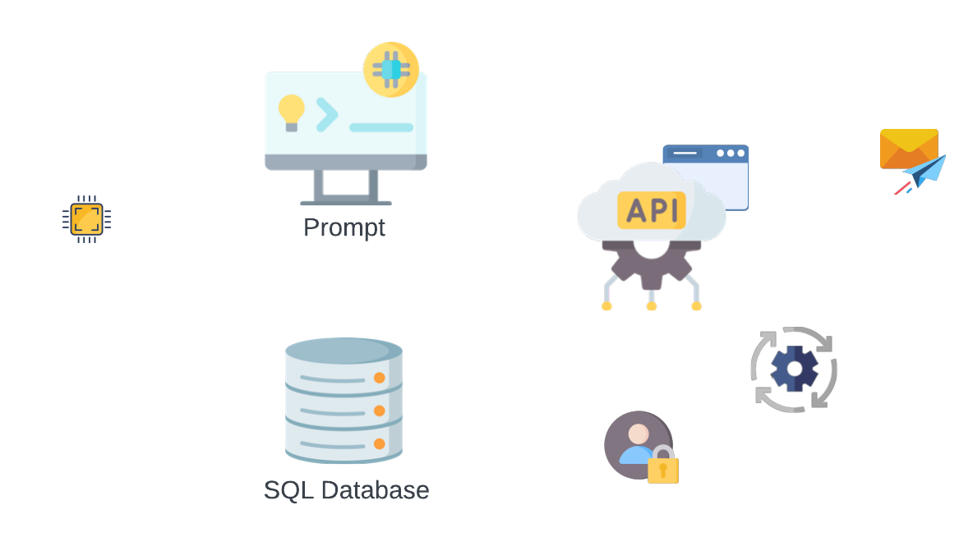

Slide 10

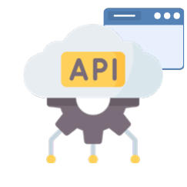
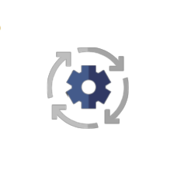



Slide 11
GenAI Logic
Kickstart
Declarative, Standards-based Development
Standard Container Deployment
GenAI: speed and simplicity
Logic: screens and behavior
Solid Dev Transition:
Requirements
Technology
Power: Declarative Logic
Flexibility: Standard Tools
Scalable Containers
Deploy Anywhere

Slide 12
Kickstart
- Idea to Run: 1 Minute
- Zero Training
- Declarative Logic
Dev
- Declarative Logic
- Standard IDE, Tools
- Custom Apps:
- Low Code
- AI/Dev
- etc…
Deploy
- Scalable Containers
- No Fees
Solid API Logic Server Architecture
Solid Requirements

Slide 13




Slide 14

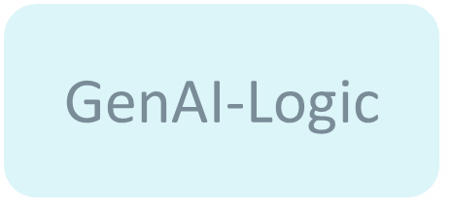


Slide 15
